Slide 1
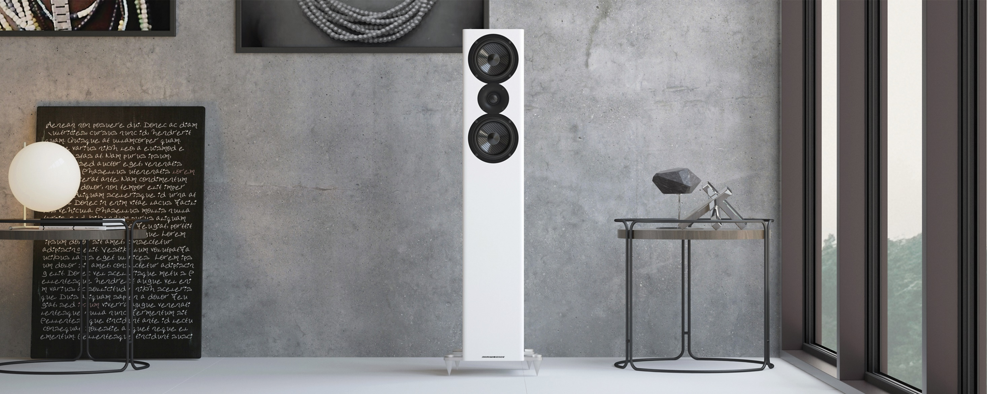
WELCOME TO ACOUSTIC ENERGY - 2021

Slide 2
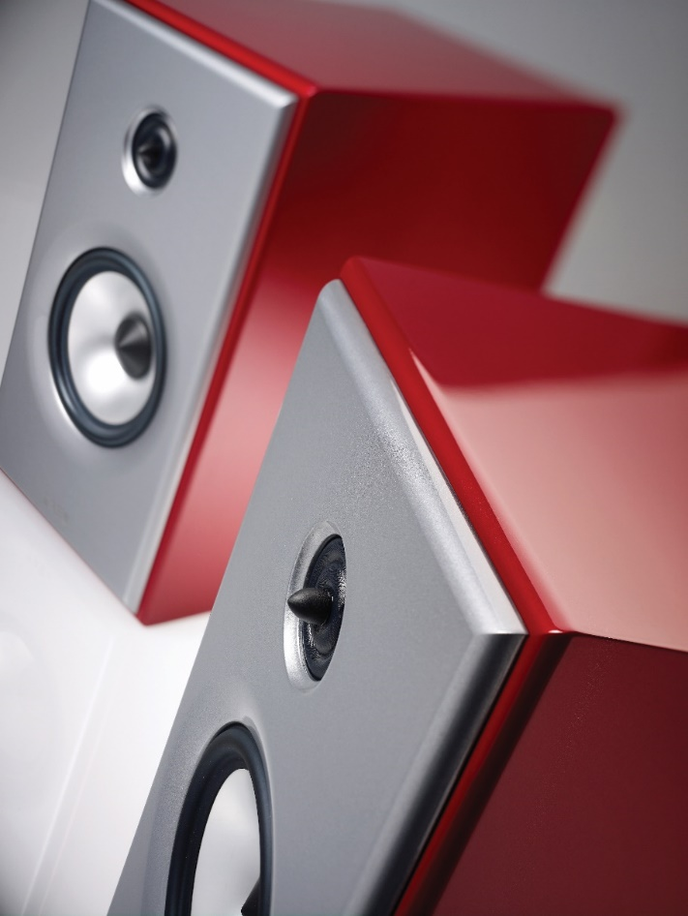
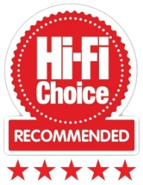
OUR JOURNEY
Acoustic Energy was originally founded in West London in 1987. Our first product was the legendary world-renowned loudspeaker, the AE1. Originally designed as a near field monitor by Phil Jones, his goal was to “improve the quality of music reproduction by absolute resolution, as good music should not be played on bad speakers”.
The AE1 set new industry standards in audio performance from a compact enclosure, creating the company’s product ethos, that we have maintained to this day, adding in the latest technologies .
In the mid-90s Acoustic Energy partnered with an overseas manufacturer FPI, enabling the brand to expand its global reach through a wider product portfolio.
Our loudspeakers have always received critical acclaim from audio journalists around the world, helping to secure our status as one of the most highly regarded British brands in the audio industry.

Slide 3
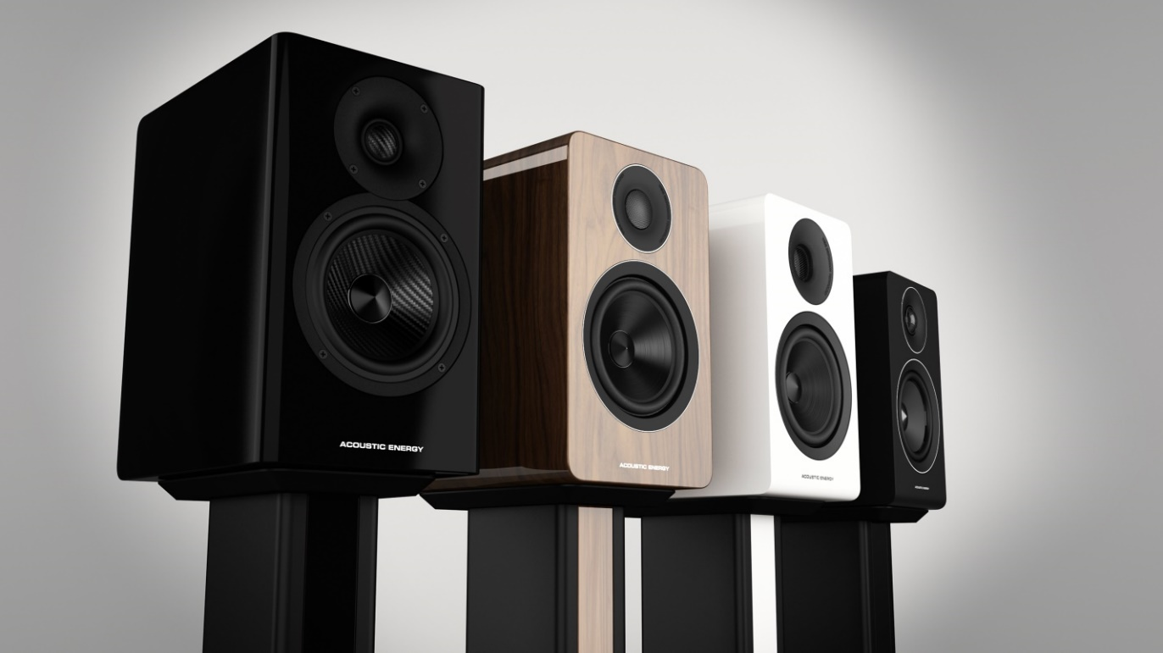
OUR OWNERS
In 2017 Acoustic Energy became wholly British owned again. Music lovers Mat Spandl, Neil Truckell, James Luce and Martin Harding have been involved with the company for over 20 years and combine 100 years of experience in the audio industry.
With three decades of audio heritage and an impressive product roadmap, the directors launched a successful bid to buy the company from its Malaysian parent and we’ve been growing the business ever since.
The whole current product line was developed by this team since the buyout – and of course more is coming!
CHALLENGES.
Despite all the challenges of COVID we were able to grow our business
by over 20% in 2020 – so thank you for helping make that happen.
Stock shortages due to factory and shipping delays are still a big nuisance
but we have significantly increased our orders so even after longer than
normal lead times we should be back to a full stock position by the summer.
BREXIT has of course also given us some recent challenges…

Slide 4
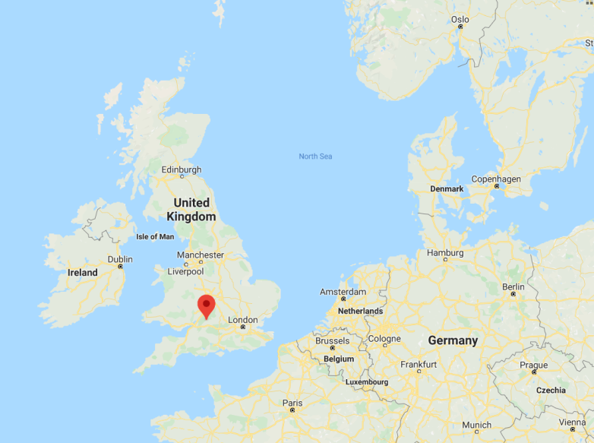
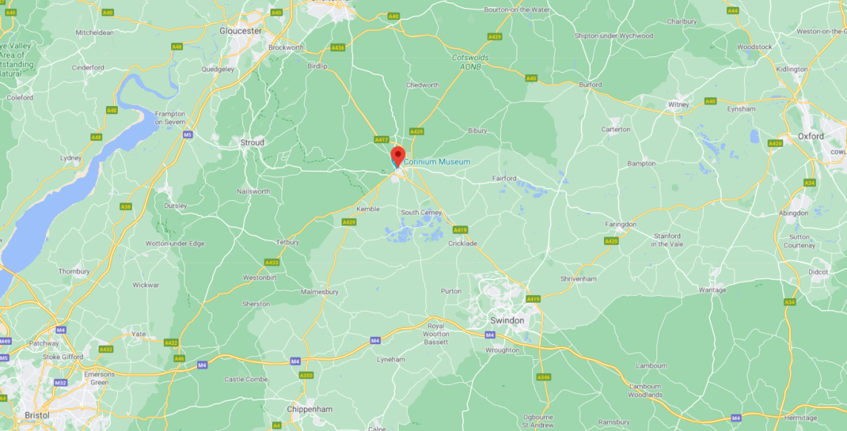
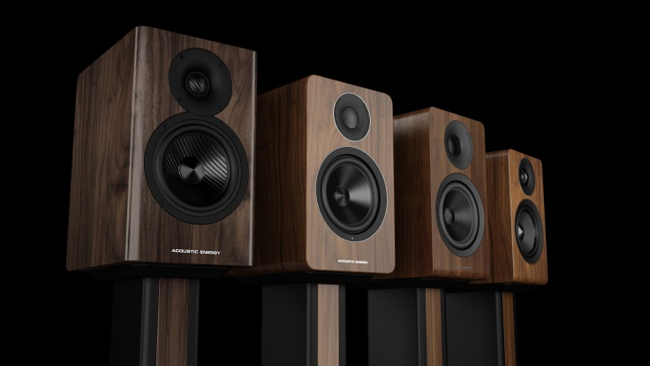
WE’RE MOVING
Acoustic Energy moves to a new home this summer
In a few months time Acoustic Energy will be moving in to our new UK home, close to where we have been located for the past 15+ years in Cirencester in the West of England.
Its time for a new chapter in Acoustic Energy’s long 30 year + history and to move to a new smaller building where we can continue to develop more award winning Speakers to add to our line up instead of moving boxes in and out of the building.

Slide 5
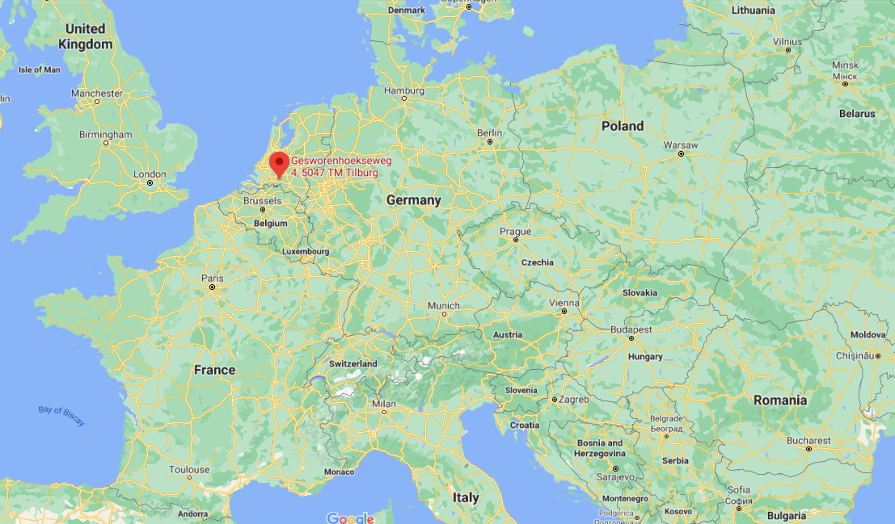
… AND OUR WAREHOUSE IS MOVING TOO – TO THE NETHERLANDS!
… AND the Acoustic Energy warehouse will move from the UK to the Netherlands next month, putting our inventory back in the EU.
In conjunction with AE moving to a new home in the UK in June 2021 (where we will only keep enough stock for the local UK Market), our main warehouse to supply our customers around the World (and especially in EMEA,) will move to a 3PL company in the Netherlands called LUDOMA SERVICES in Tilburg, the Netherlands.
This is a specialised, family owned AV distribution company that we have known for 25 years personally, and AV EMEA have been working with for the past ten years, and the following brands are all warehoused in the same company – Parasound, TDG Audio, Torus Power, Powergrip, Soundcast, Como Audio, NAD, Bluesound , Peachtree Audio and now Acoustic Energy too!
Benefit s for you – increased efficiency – using a professional logistics
Company based in the EU will increase service and probably save you
money too

Slide 6
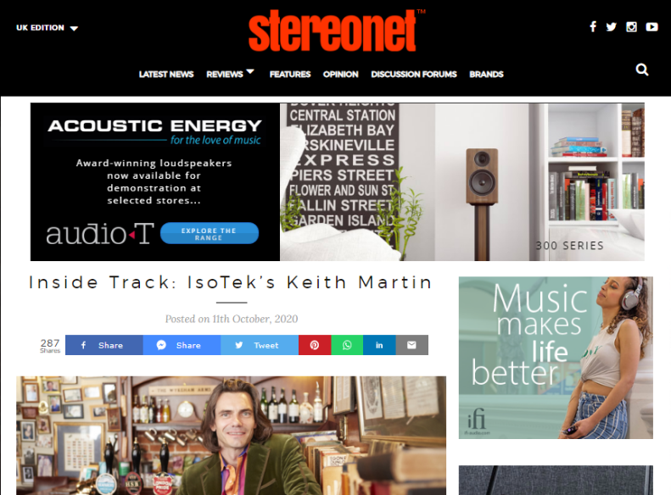
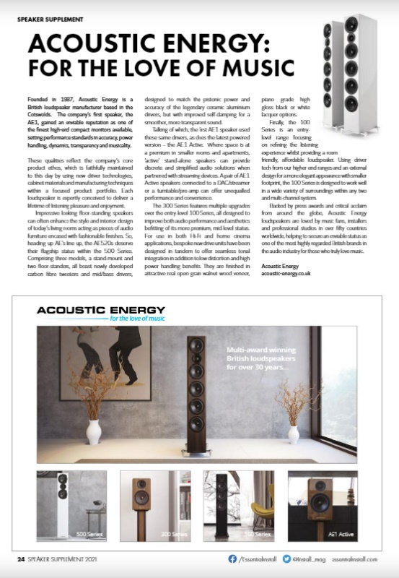
MARKETING UPDATE
MARKETING RESOURCES ON OUR WEBSITE
Password: AE1987
We are adding new things quite often to check in here regularly
10 ‘Award Winners’ for various AE models in the past 6 months in UK Press and Online Magazines.
5 ‘International Award Winners’ including a prestigious ‘Diapason D’Or award for the AE509.
(Don’t forget to copy us on any reviews in your country too!)
YouTube Reviewers.
UK Web Banners.
Print campaign in Essential Install Magazine
Website SEO Improvements resulting in 20-25% increased traffic
Social Media activity
Coming – Video content for online use

Slide 7
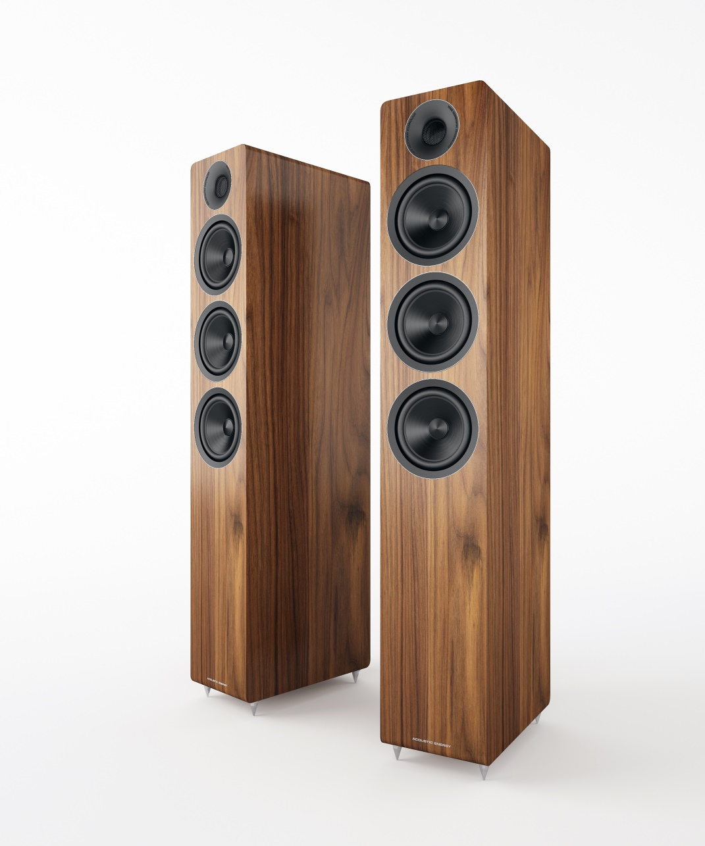
WHATS NEXT!
Say hello to our new AE320 !
Our 300 Series has been very successful for us and is the ‘sweet spot’’ in terns of performance, value, price and profit .
We have however had quite a price jump from our floor standing AE309 up to our AE509 – going from Eu 1290 for the 309 up to Eu 2750 for the 509.
The 320 will fit nicely in the middle at Eu 1999 (target)
It is a true three- way with the first mid-woofer being it its own sealed enclosure (like a 520)
The 320 of course has the same cone material and Tweeter as the other 300 Series models
The 320 will be available in Gloss Black and White and real walnut veneer like the rest of the range, and will be available this summer.

Slide 8
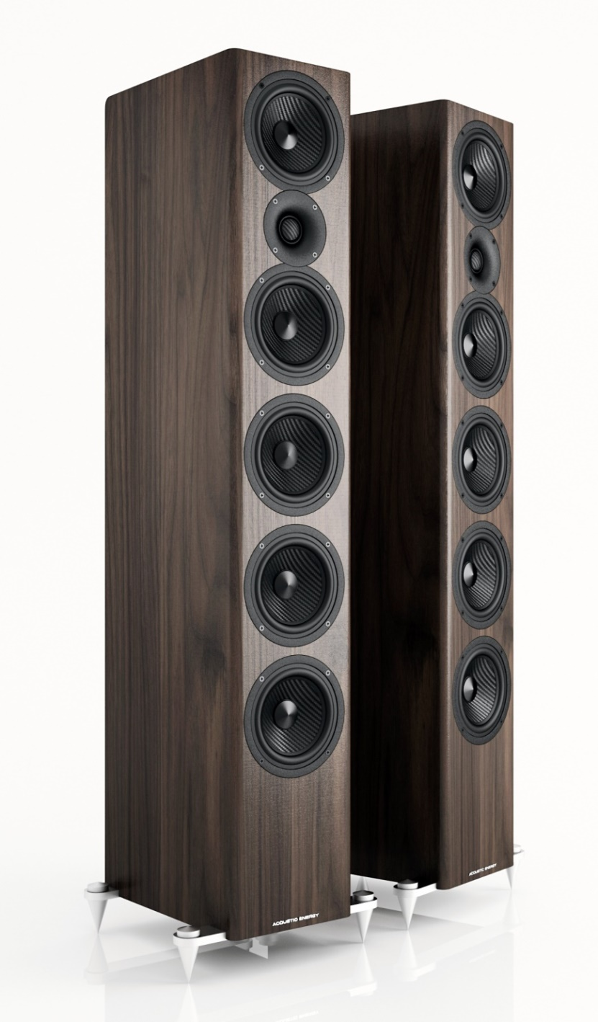
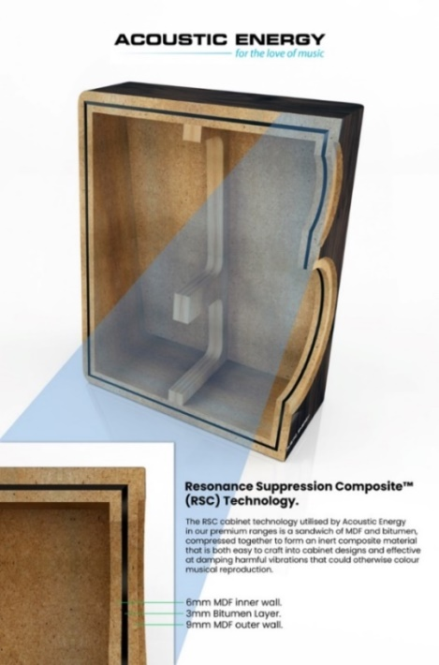
AE520 – OUR LATEST SUCCESS STORY! SO WHAT COMES NEXT?
Our new top-of-the-range for the 500 Series, the 520 has been a great success, winning many international awards and proving that AE can build a great value product at a higher price point and beat the competition on quality, sound AND price. Many have said that the 520 is 30% cheaper than its closest competitor. Featuring 3 dedicated woofers to complement the MTM design. It shares the slim-line floor-standing style of the 509 but has much higher power handling – and the natural ‘step down’ from the 520 can now be the 509 – or the new 320.
All 500 Series models feature
the RSC cabinet bracing technology.
Specifications
Sensitivity: 90dB
Power handling: 300W
Impedance: 6 ohms
Bandwidth: 30Hz – 28kHz
Height 113cm (the 509 is 105cm)

Slide 9
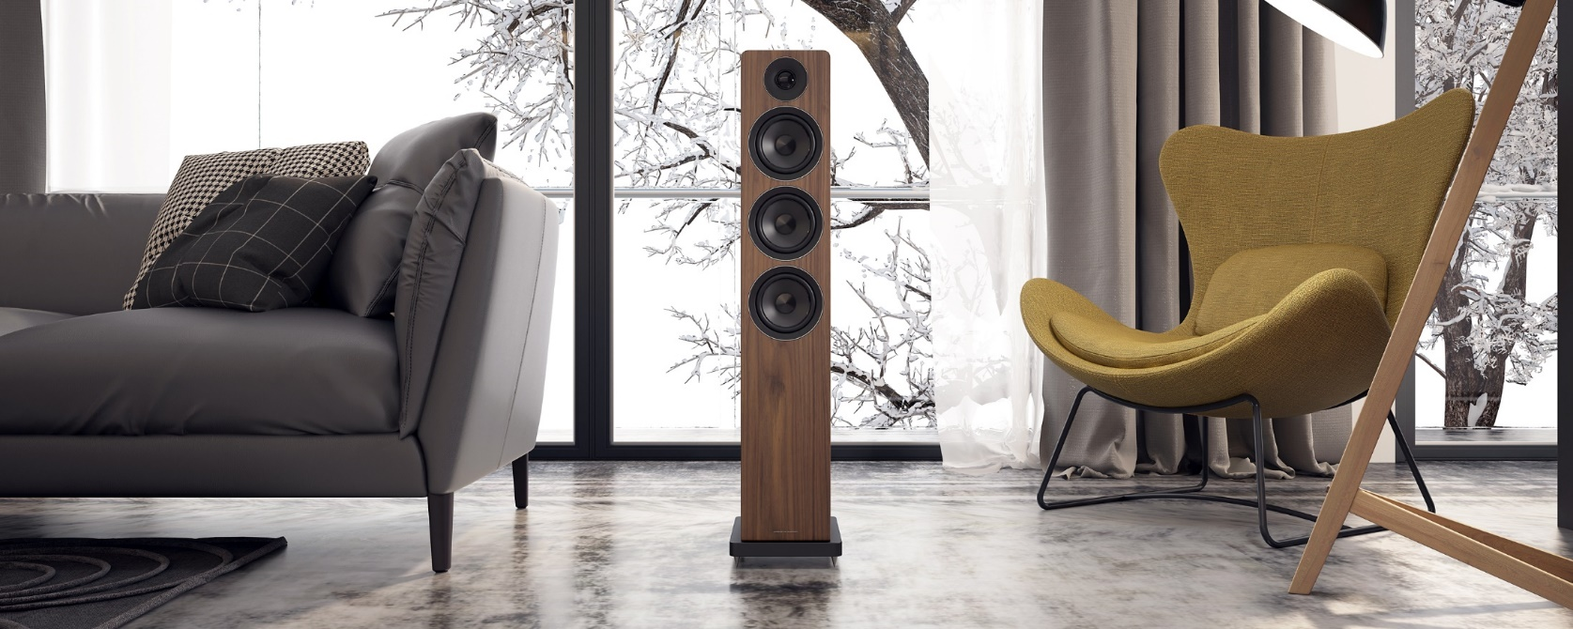
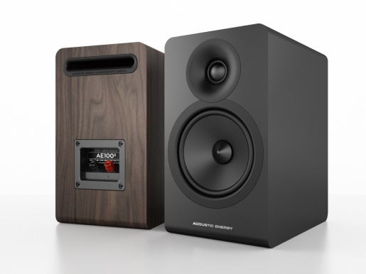
100 SERIES 2021 LONGER TERM PLANS
We are hard at work on the upgrade to the 100 Series which we will be moving to the same factory who builds the Award Winning AE1 ACTIVE.
This is just for your information at this point as we have multiple production orders still in process on the current models and we will not start to transition until late in the year
The upgraded 100 Series introduces a number of evolutionary changes focused on refining the listening experience WITHOUT increasing the price (all being well!)
We will use a high force, long throw motor systems which are reflex loaded through slot ports located to the rear of the 100s, 109s and 107 enclosures for less midrange colouration and improved bass response.
Below is a simple rendering of the look of the upgraded series

Slide 10
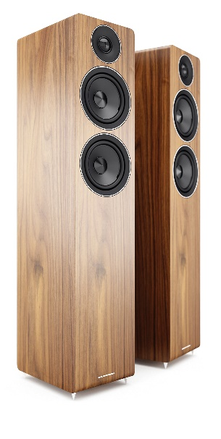
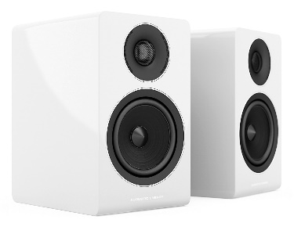
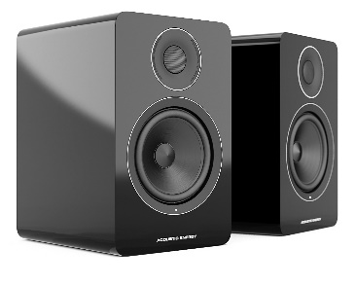
OUR PRODUCTS and our PRICING
PRODUCT LINE UP 2019
300 Series
AE1 Active
500 Series
100 Series
And finally a little bad news….
Unfortunately we have to pass on a small price rise from 1st May due to increased factory costs.
This will be a 4% increase.
Any back orders already on order and shipped after 1st May will be charged at the existing pricing.
There will be a new 15.00 charge on small orders under 1000

Slide 11
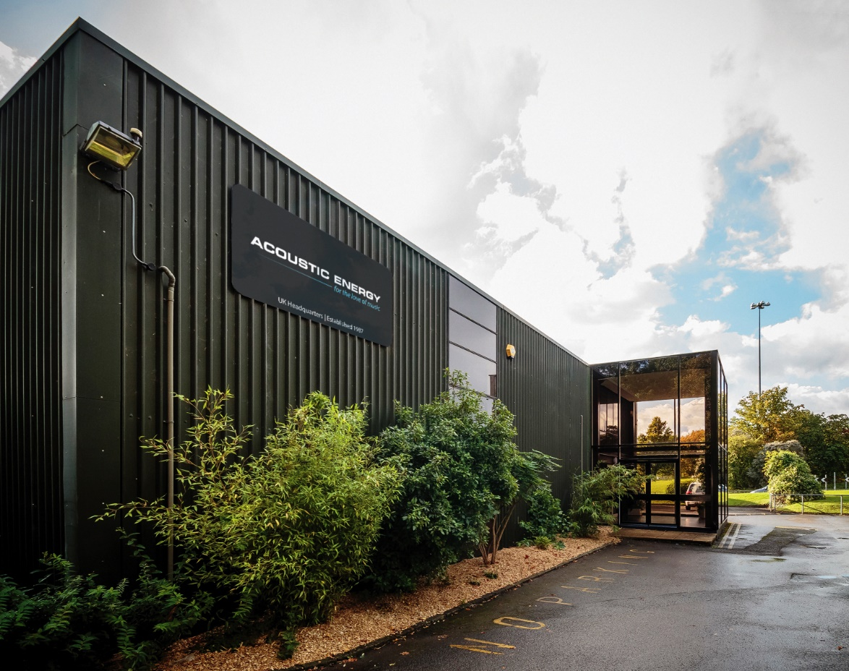
THANKS FOR JOINING US TODAY
GOODBYE to OUR OLD BUILDING THIS SUMMER!

