Slide 1
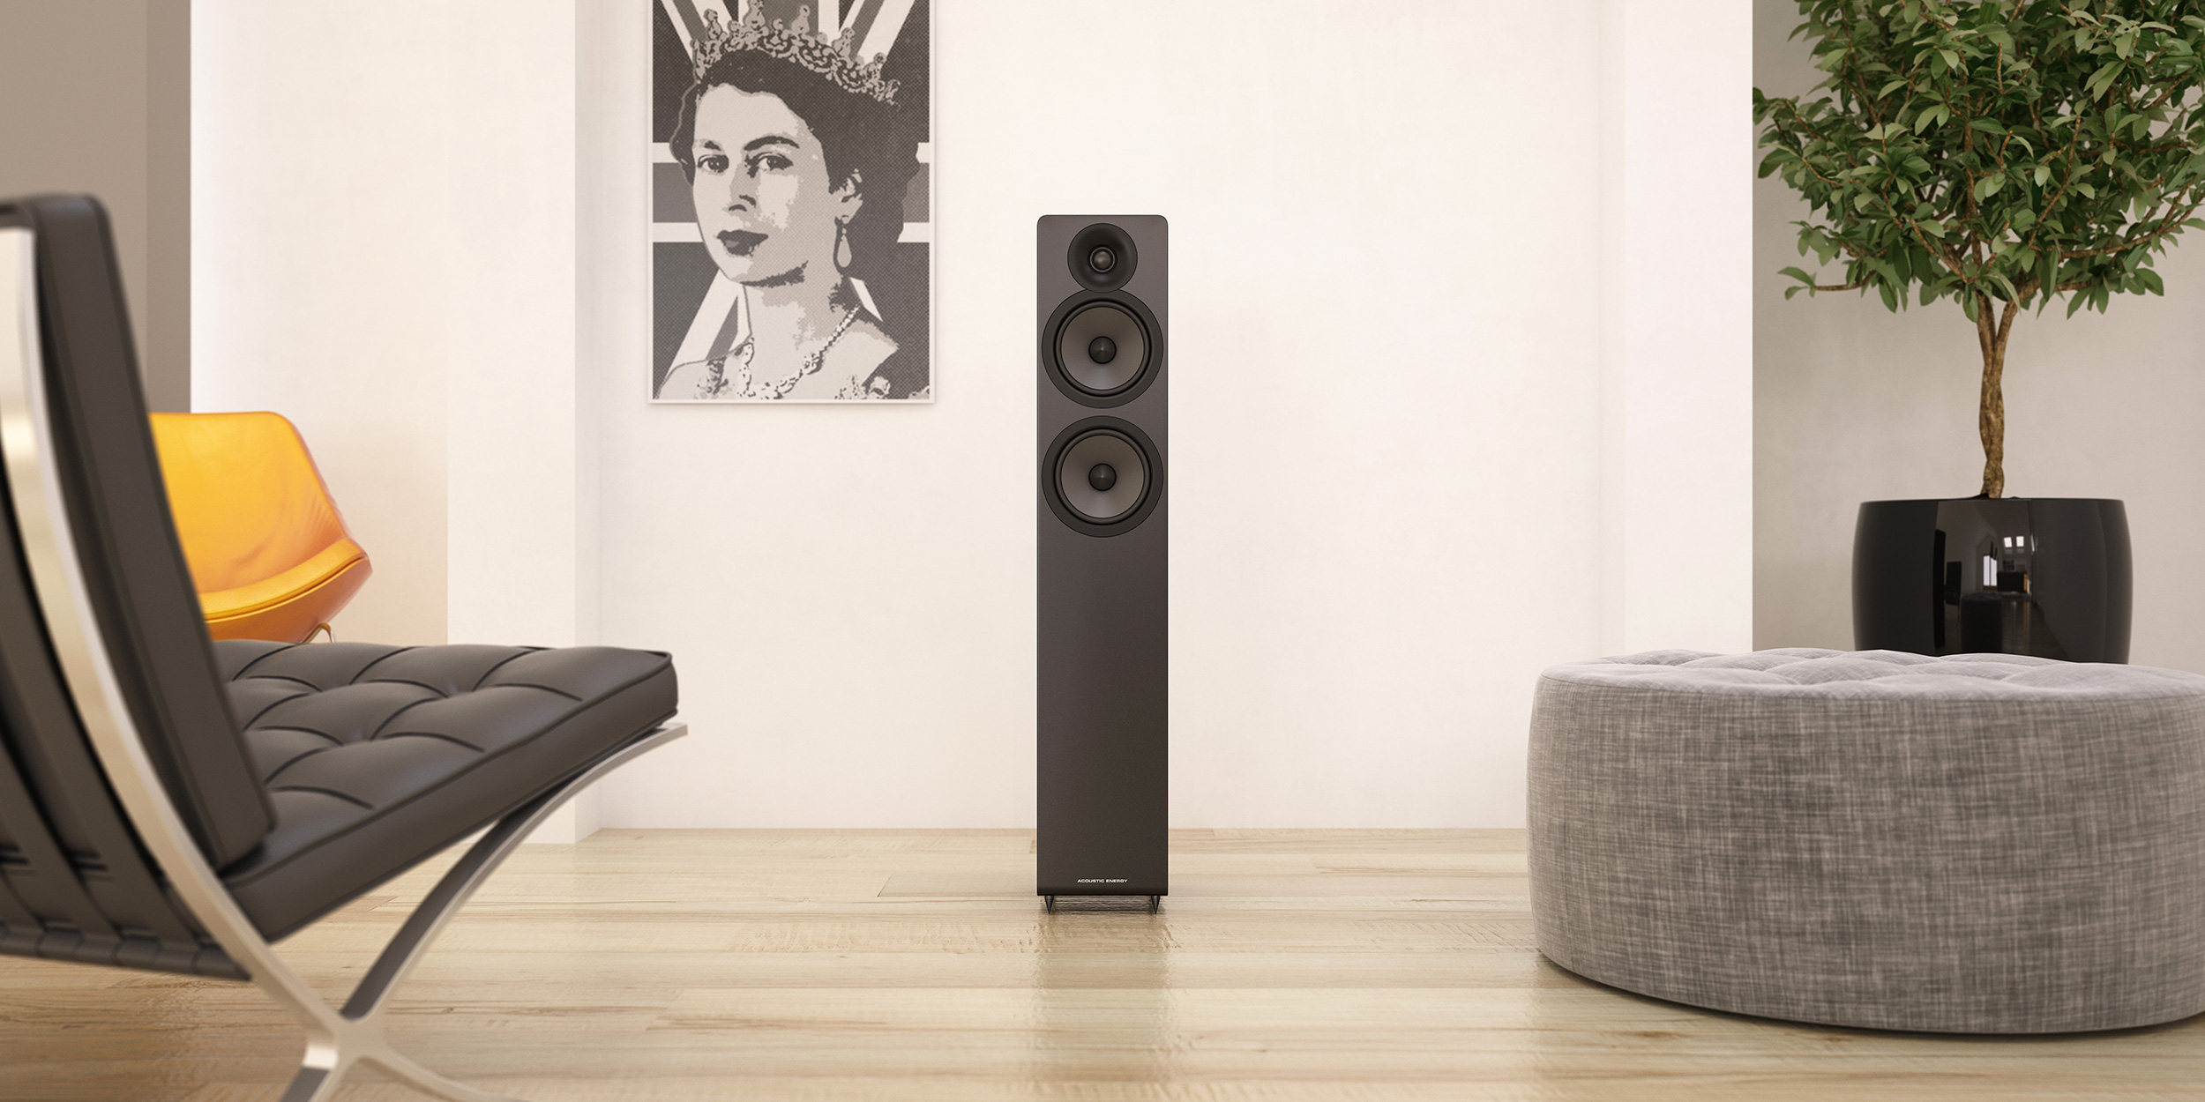

TECHNICAL
INFOMATION

Slide 2
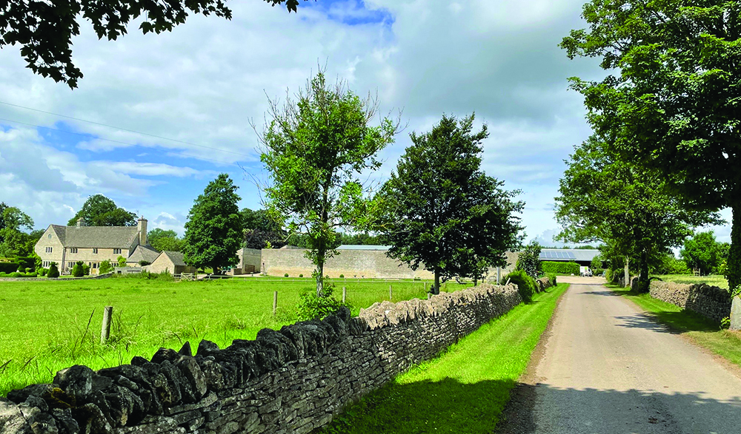
“Here at Acoustic Energy, from our base in the beautiful English countryside, our goal is to design loudspeakers offering an unparalleled combination of performance, quality and value.
We believe that a great speaker should simply disappear, allowing music to flow through it, retaining all the passion, emotion and energy of the original performance.
Every speaker we create is engineered to get as close as possible to that goal - enabling the music to remain as natural and enjoyable as the moment it was created. We design for the love of music.”
Mat Spandl, MD & Chief Engineer.
THE AE SOUND

Slide 3
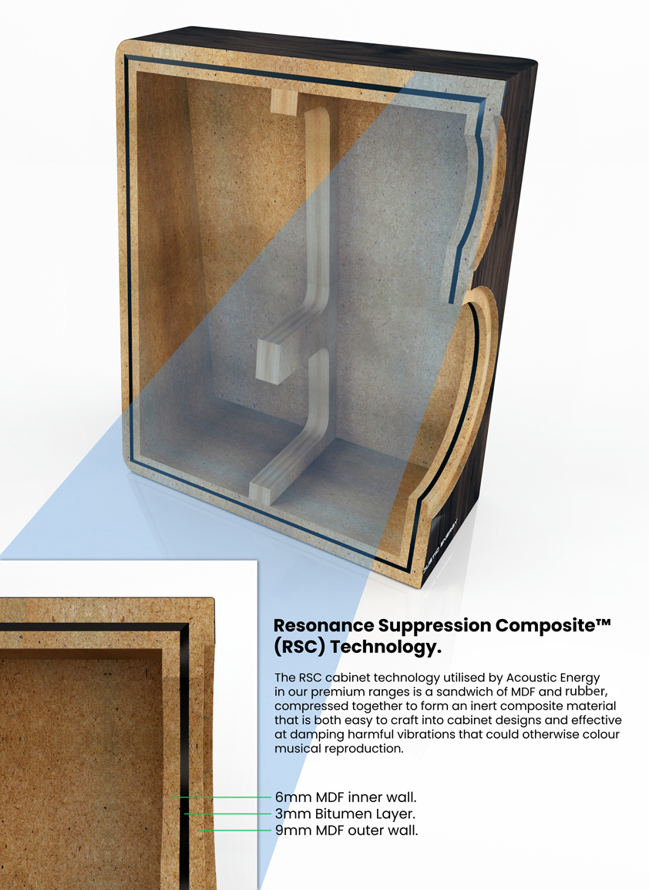
AE’s philosophy on cabinet construction is to prohibit unwanted resonances from contributing to the sound. The basic rule of acoustic insulation being that mass suppresses sound, so even our entry-level speakers feature heavy High Density Fibreboard (HDF) cabinets – feeling weighty compared to most similarly priced competition.
Our higher-end speaker ranges take this philosophy further by utilising Resonance Suppression Composite (RSC) Technology - a high mass inert layer sandwiched between two sheets of MDF to create self damping, inert panels. These are both heavier than standard cabinet materials and better damped. When placing your ear against these cabinets while music is playing it becomes obvious the sound radiation is far lower than traditional MDF or plywood cabinets.
This high-mass philosophy was established with the original AE1 speaker in 1987 which used a latex-based concrete to line the interior of the cabinet. A key part of the speaker’s sonic signature, this feature boasted a ‘wow’ factor by enabling the music to be played louder and more cleanly than other speakers of the era.
CABINET

Slide 4
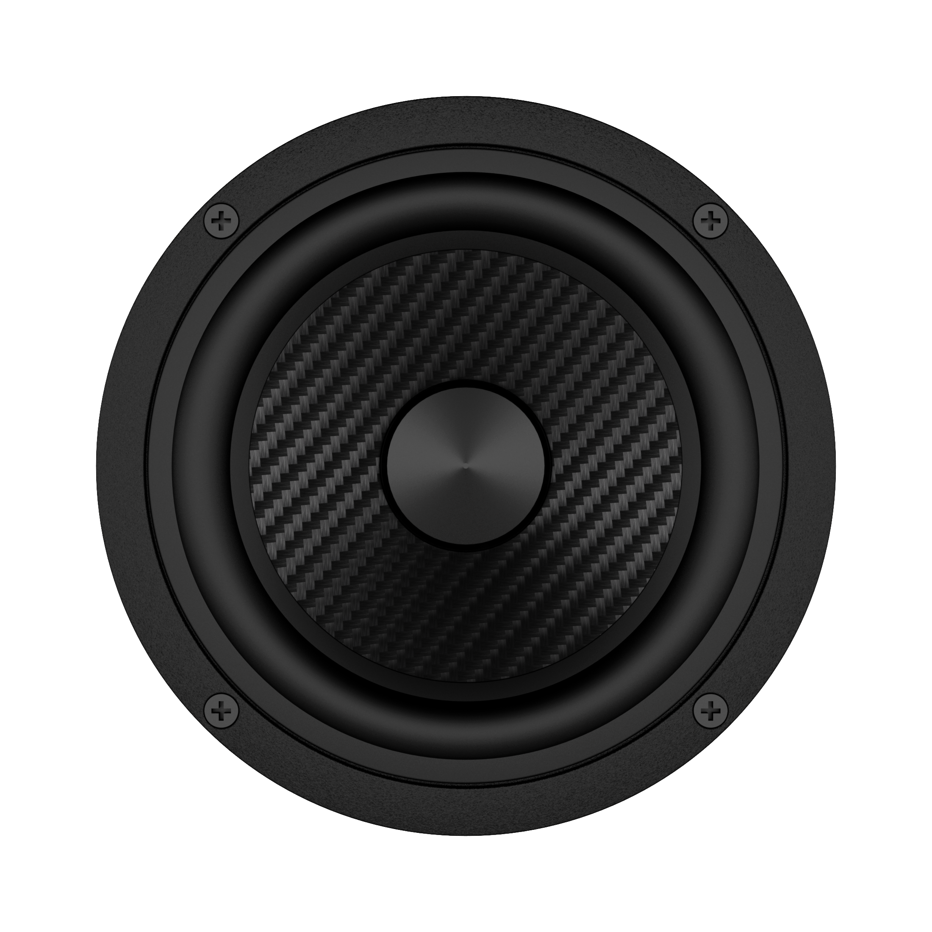
The AE sound has always been punchy and clean without stored energy or overhang to get in the way of the music. Our tradition has been to use strong, anodised aluminium cones to achieve this. More recently we have been working with more exotic materials such as carbon fibre which is even lighter and stronger than aluminium, whilst at the same time benefitting from improved damping. This has resulted in even lower colouration along with excellent durability.
One particular performance aspect we try to maintain from the original AE1 is the pure pistonic nature of its hard-anodised cone. The less a speaker cone flexes throughout its movement cycle the more it retains its sonic signature, even at very high volumes. Cone break-up needs to be well controlled to achieve this and is something we’ve aimed to master over the years, tailoring every element of drive unit construction specifically for each particular cone material, be it coated paper, aluminium or carbon fibre.
WOOFER

Slide 5
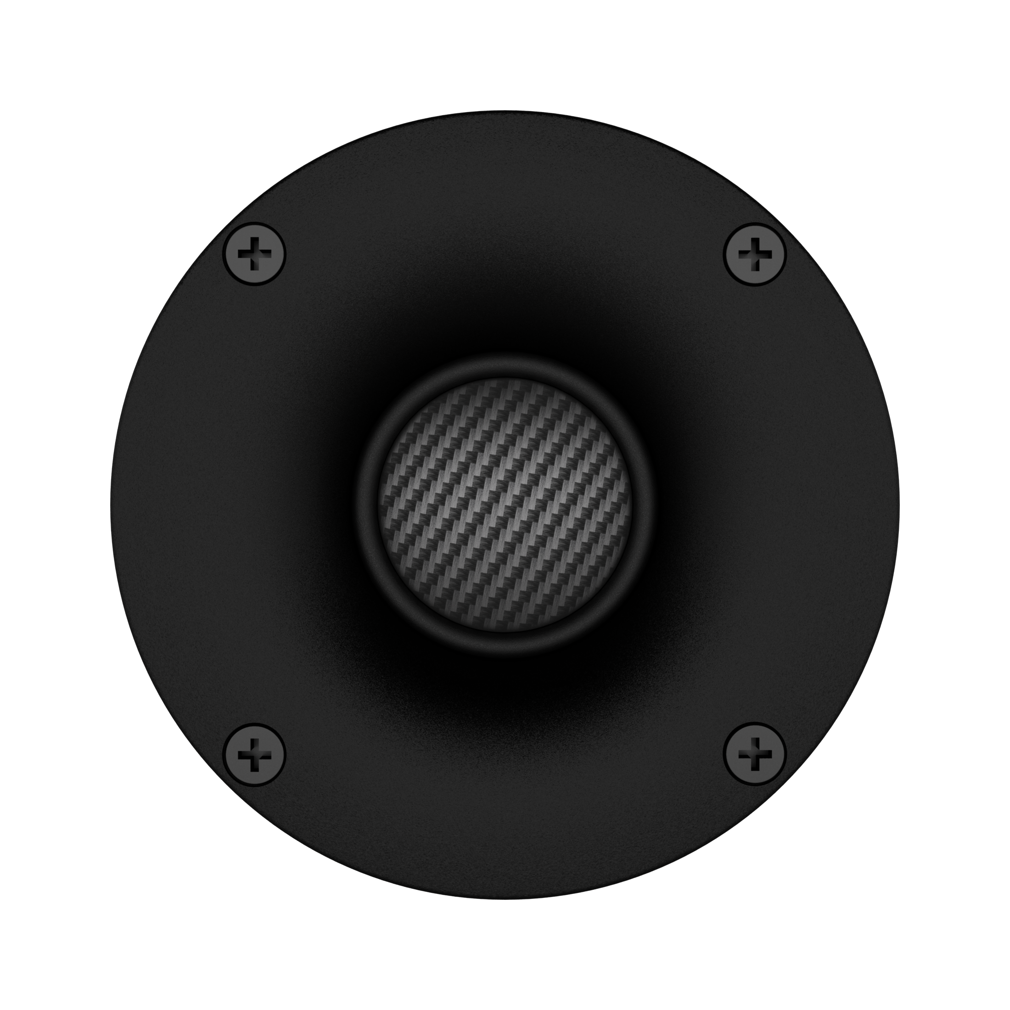
We always prefer to match the materials and tonal qualities of our tweeters and woofers. This means our paper cone woofers are matched with fabric dome tweeters, our aluminium cone woofers with aluminium domes and even our carbon fibre cones are matched with similar carbon fibre dome tweeters – all maintaining cohesive sonic characteristics across the frequency band. With improving material options we will always chose the best solution for the job, and are not wed to any particular material.
All AE tweeters feature our bespoke Wide Dispersion Technology (WDT) waveguides to match directivity characteristics of the tweeter to the woofer through the critical crossover band, allowing tighter and more seamless integration. At very high frequencies the waveguide creates wider dispersion from the tweeter, helping to eliminate hotspots in the output. The result means optimal sound quality can be achieved throughout the listening environment and not just condensed into one central “sweet spot”.
TWEETER

Slide 6
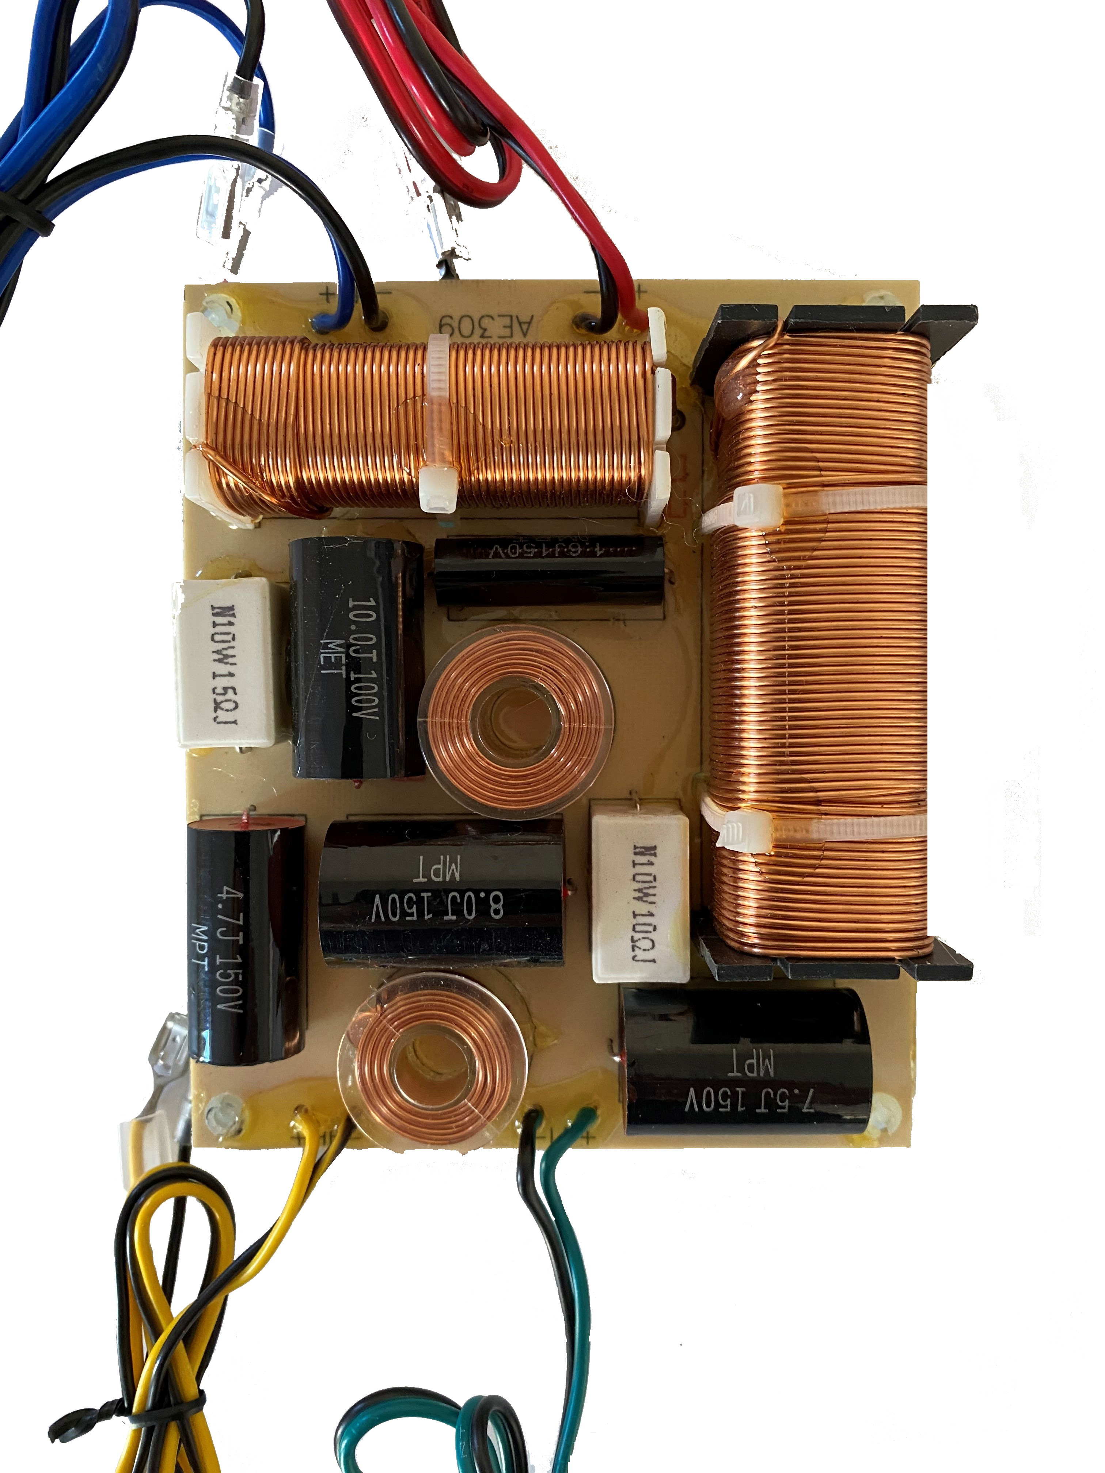
We implement the simplest possible crossovers wherever possible which still allow proper phase integration and eliminate distortion. In practice this can mean first, second or third order depending on the frequency band and drive units. Since each component used will remove a small amount of transparency, we take crossover designs very seriously to ensure nothing is wasted. We use high voltage film wound capacitors and where necessary, air core inductors (always for the High Frequencies). None of our speakers feature bi-wiring connectivity as it can introduce additional variables in the final overall sound. Our view is that one set of good quality cables will perform better than two sets of lower quality cables.
CROSSOVER

Slide 7
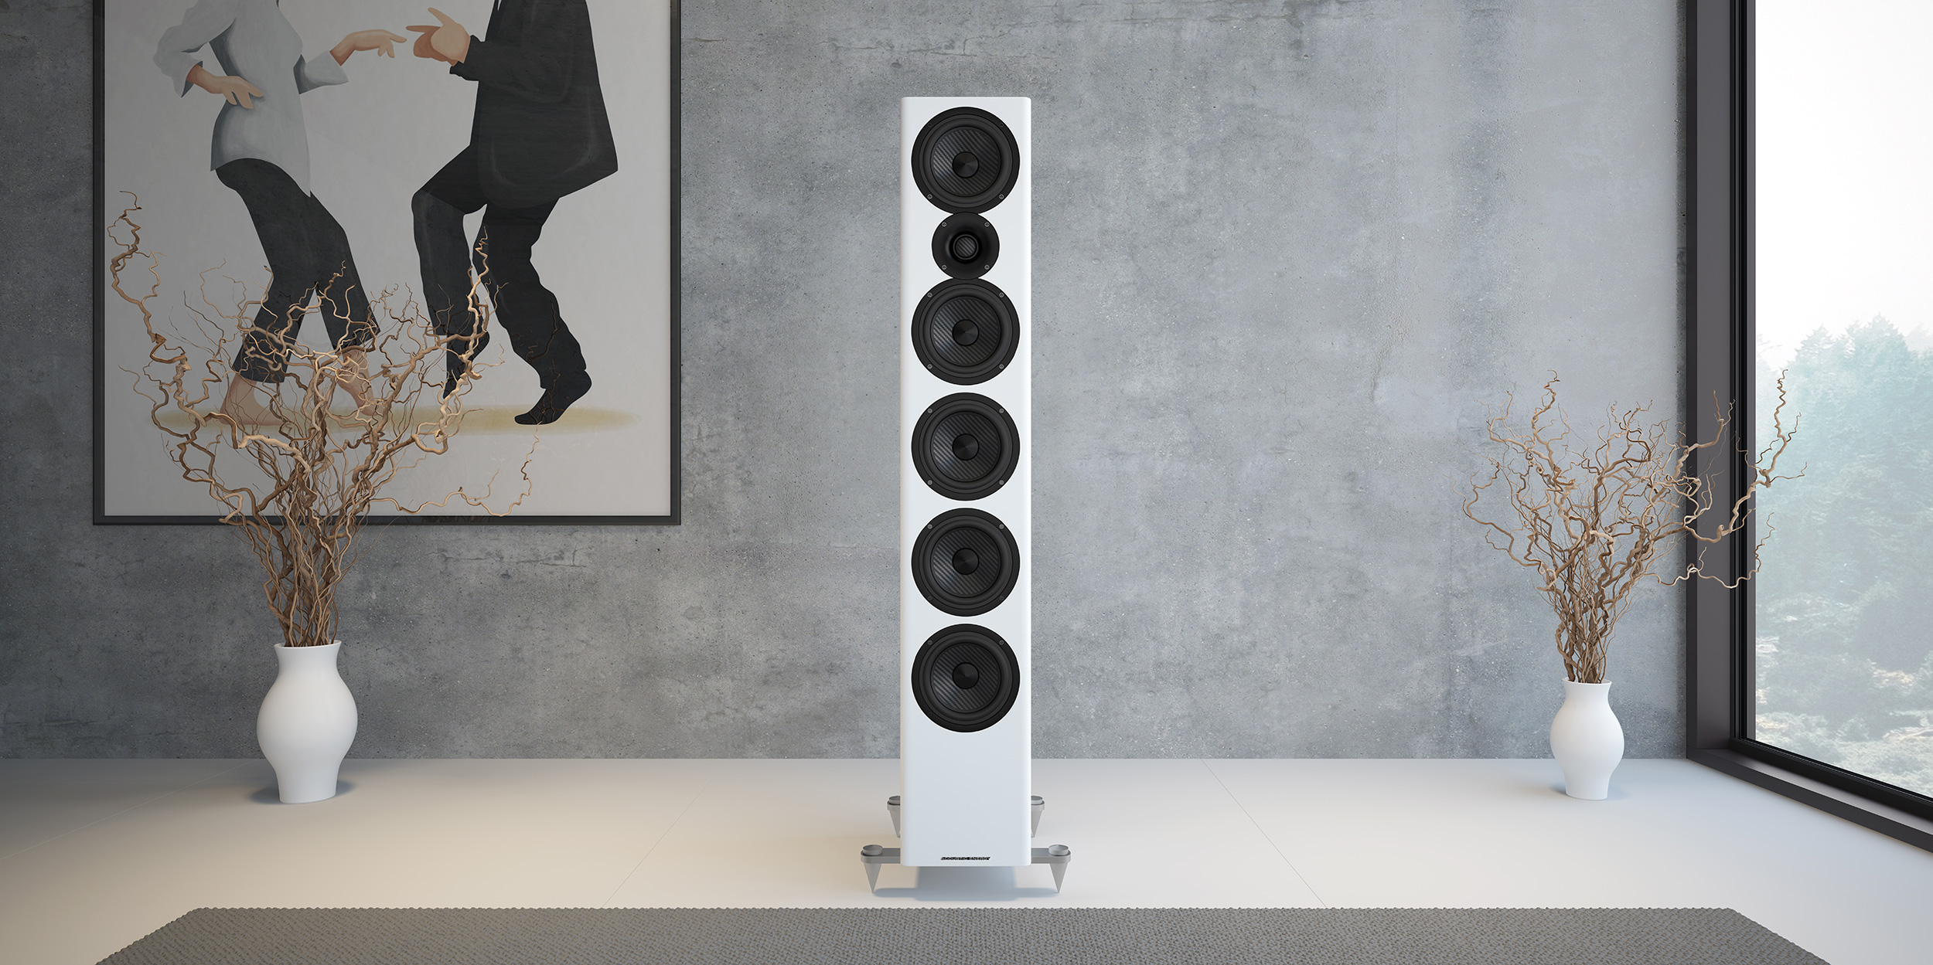
We value simplicity and elegance, where possible engineering out problems by using ingenuity rather than by adding cost. This means we can offer a very high performance to value ratio in all our products and the results can be seen through hundreds of 5-Star accolades, awards and group test wins AE speakers have earned over the years.
Every company has their own principles and design ethos, many equally as valid as they are varied. Our core principle always focuses on listening and enjoying music through our speakers first and foremost. We believe our love of what we do shines through in our products and based on the feedback we receive; end users, retailers, distributors and journalists around the globe would appear to agree…
SUMMARY

Slide 8
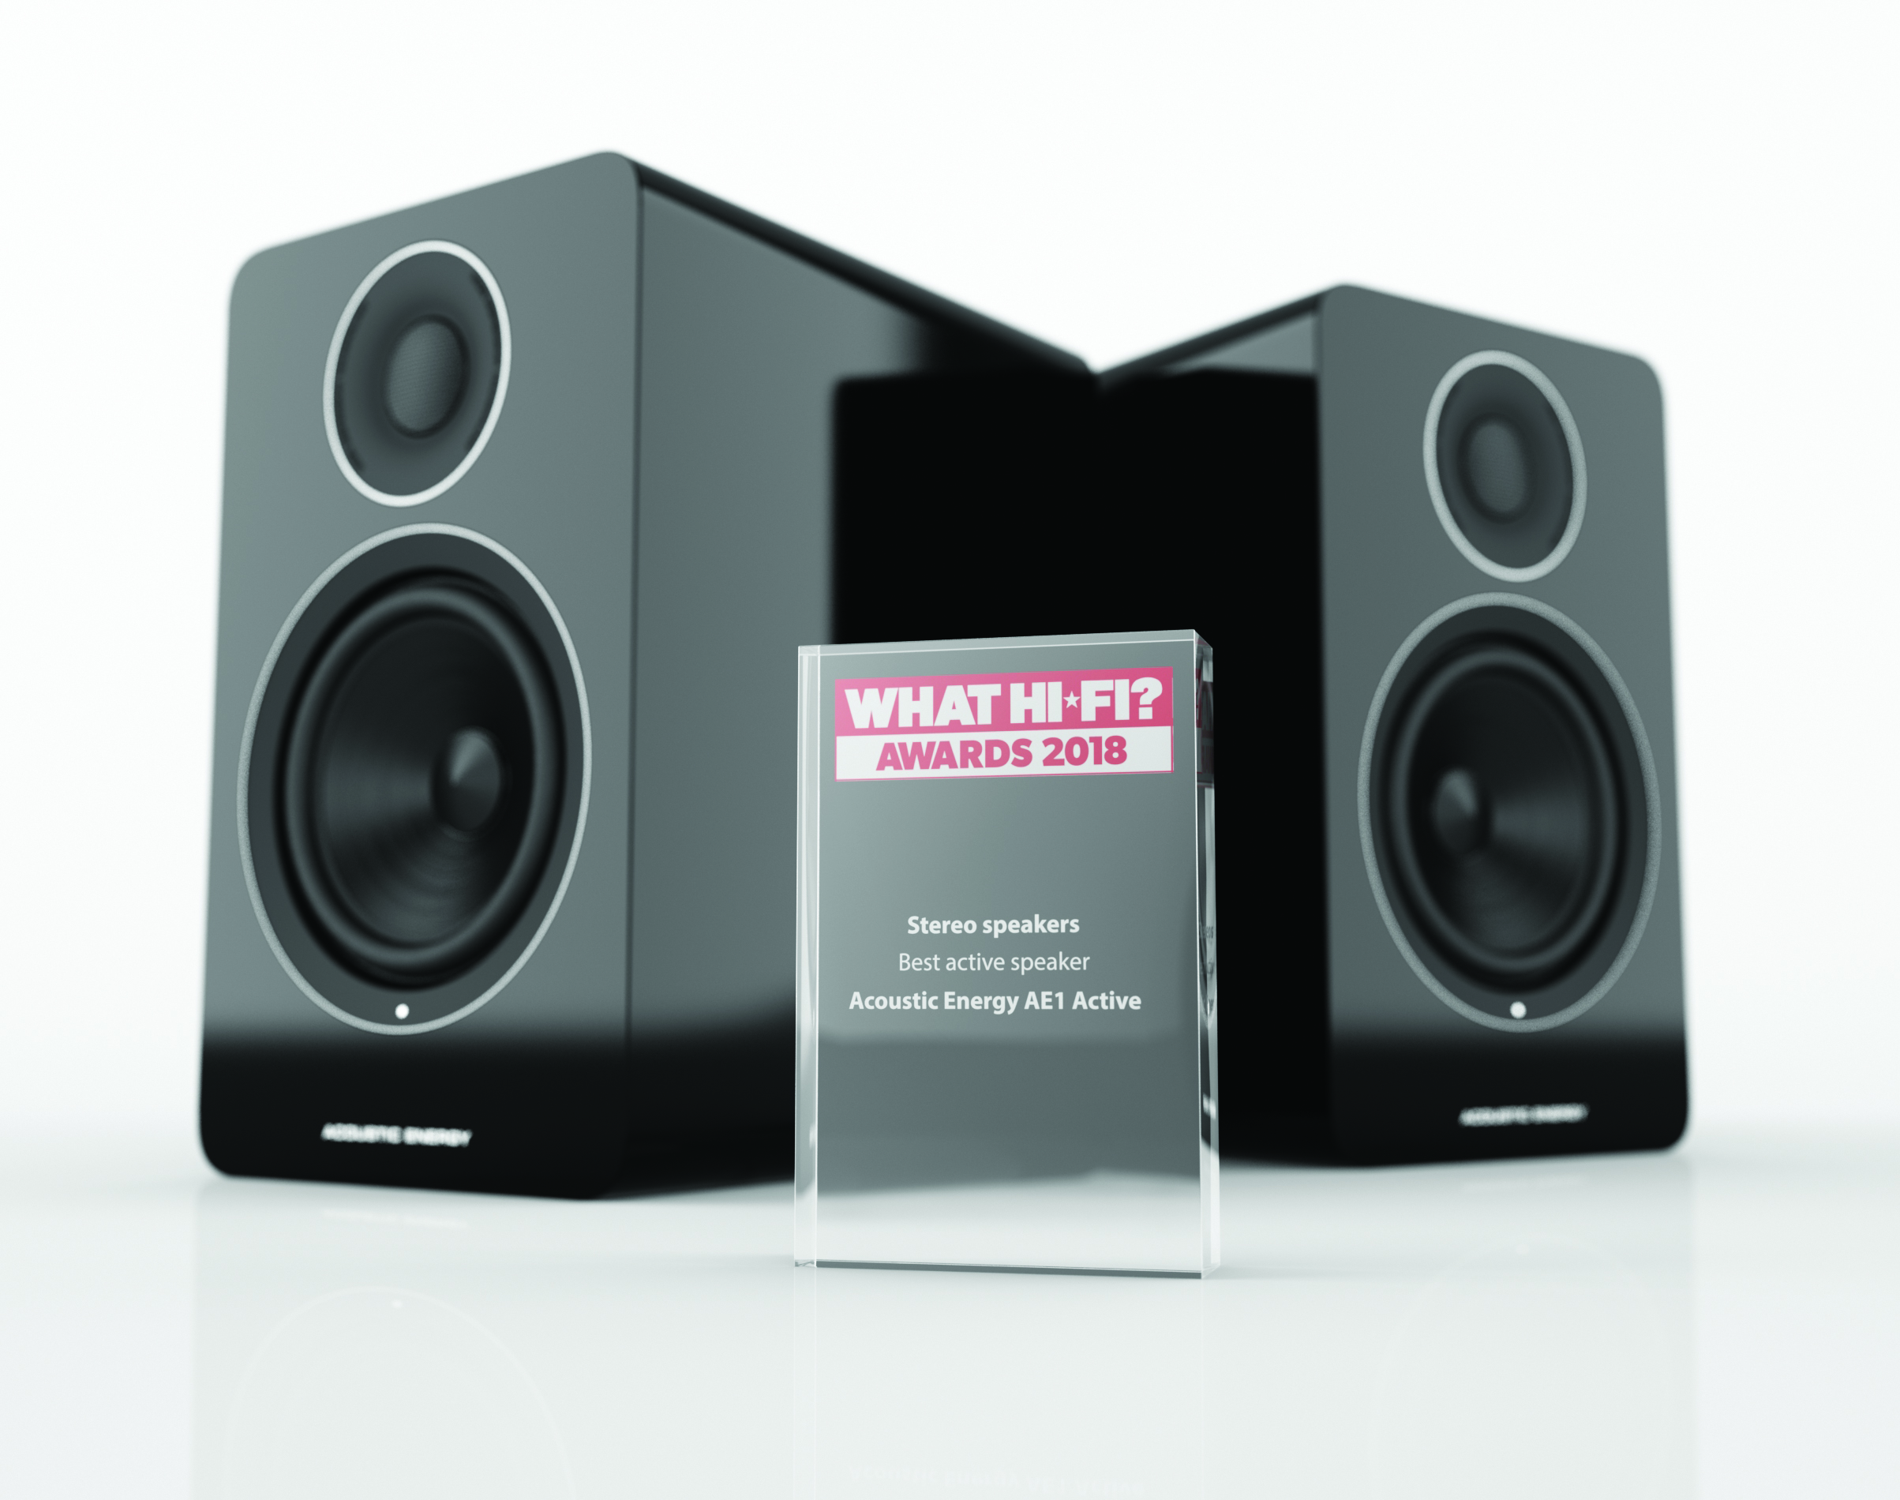

FOR MORE INFORMATION
Contact Details in here
Here
And here
Designed in the United Kingdom

